Slide 1

Future-proofing global tech governance: a bottom-up approach
IGF 2023

Slide 2



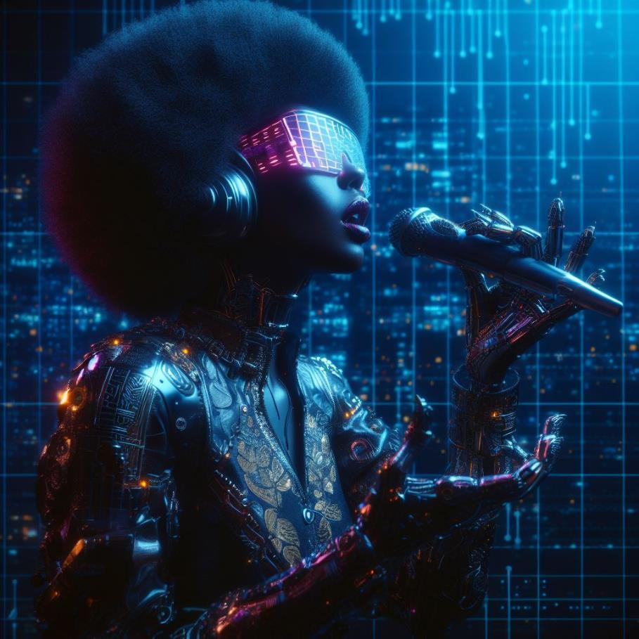


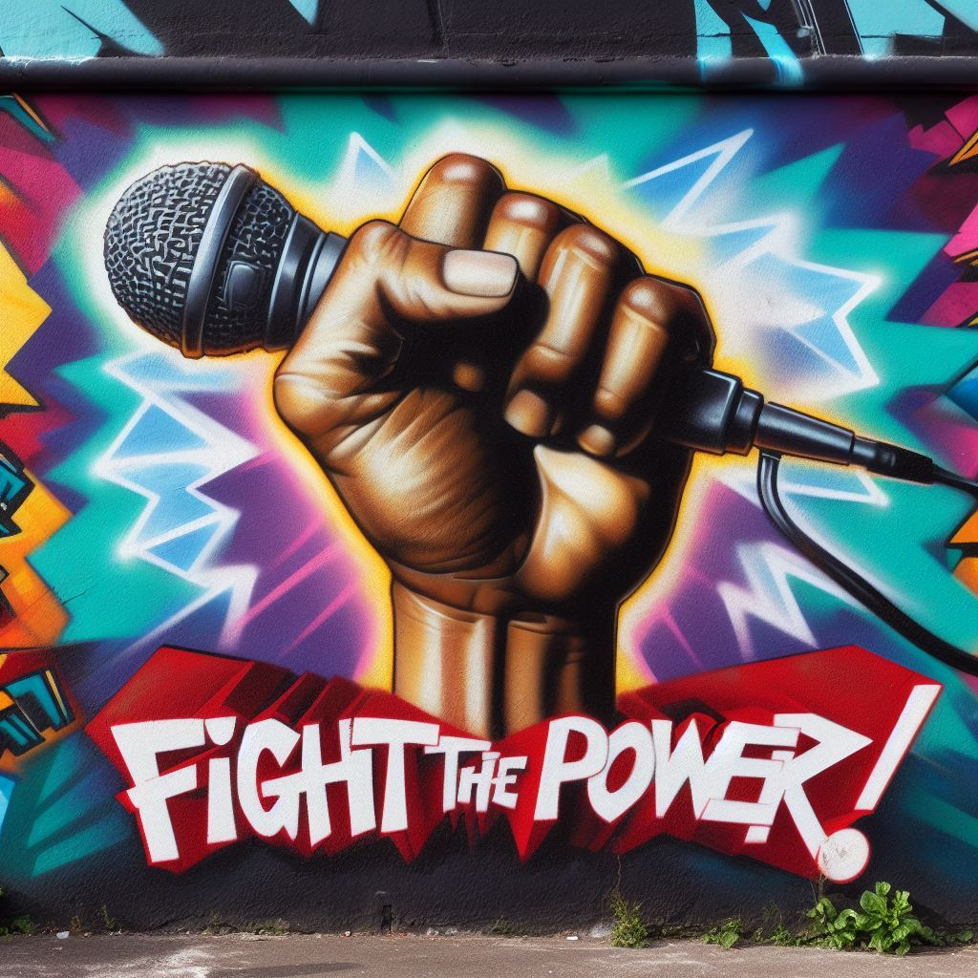
Before we start… the song challenge
Artist + song
Everything But the Girl – Rollercoaster
Sloan – The Good in Everyone
Bombay Cycle Club – Shuffle
Tina Turner – What’s Love Got to Do With It
KT Tunstall – Suddenly I See
Bruce Springsteen – Born to Run
Rage Against the Machine – Take the Power Back
Panelist
Sheetal
Thomas
Alzbeta
Gallia
Chris
Carolina
Cedric
?
?

Slide 3
Disruption
Everything But the Girl -Rollercoaster
Bombay Cycle Club - Shuffle

Slide 4
Agility – a bottom-up approach
Rage Against the Machine – Take the Power Back
Sloan –The Good in Everyone

Slide 5
Towards common principles?
Tina Turner – What’s Love Got to Do With It
Bruce Springsteen - Born to Run

Slide 6
Observations
KT Tunstall – Suddenly I see

Slide 7
Future-proofing global tech governance: a bottom-up approach
IGF 2023
Thank you!

