Slide 1

IGF 2020
Preparations
IGF Secretariat

Slide 2
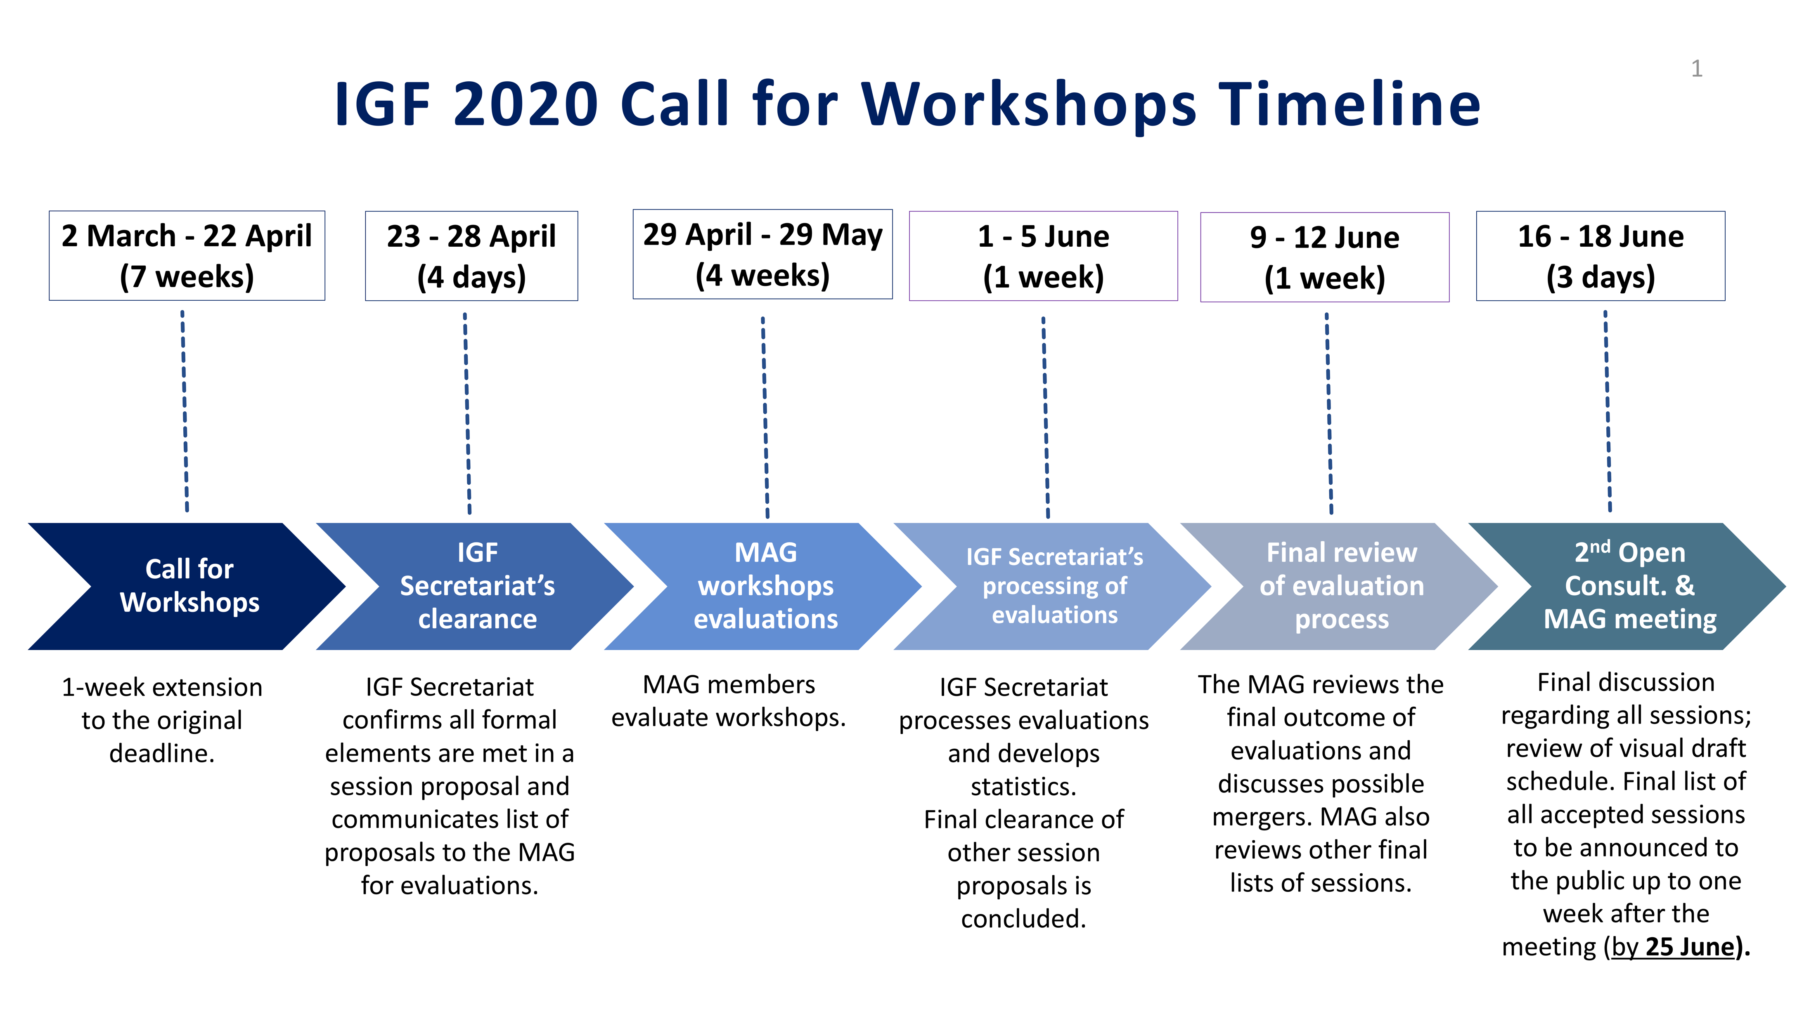

Slide 3
IGF 2020 Call for Workshops
IGF 2020 Call for Workshops was open for 7 weeks: 2 March-22 April
367 proposals created in the IGF online submission system
240 proposals submitted
237 proposals for evaluation, following the IGF Secretariat’s screening
_________________________________________________
IGF Secretariat’s screening:
3 proposals screened out as duplicates (#186; #164; #58)

Slide 4
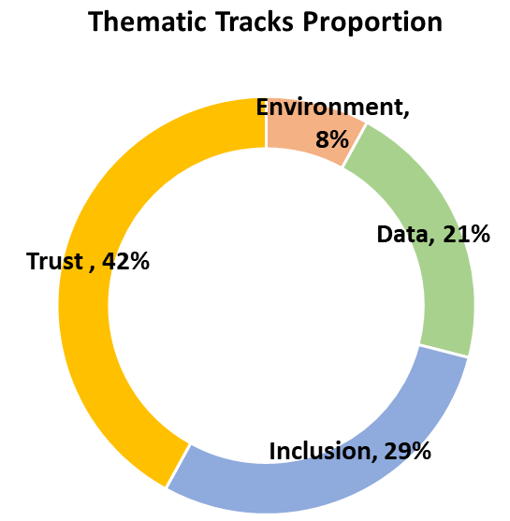
Thematic Tracks
Breakdowns for 237 workshop proposals

Slide 5
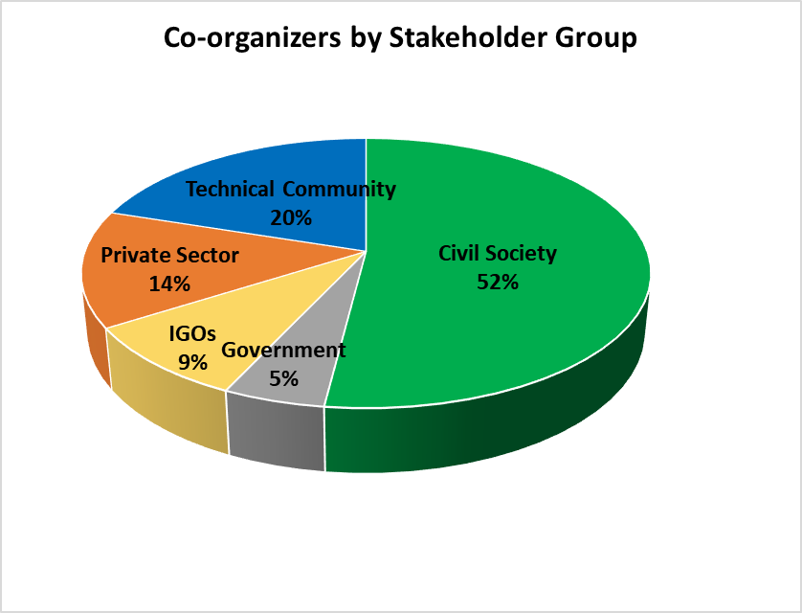
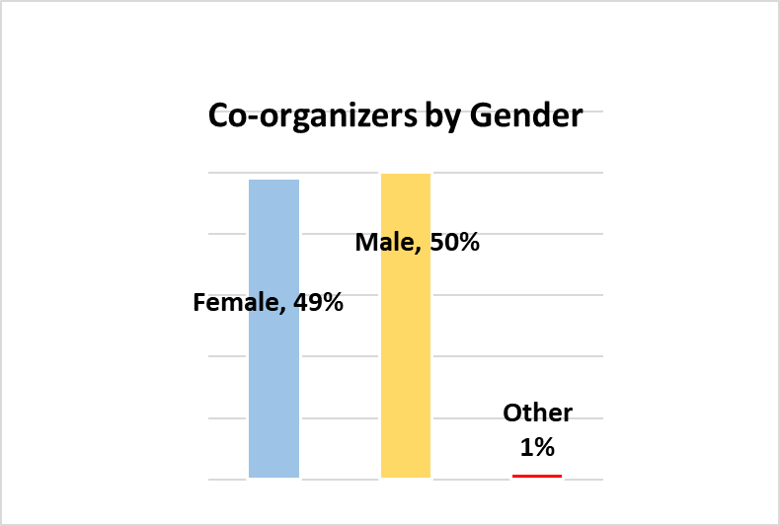
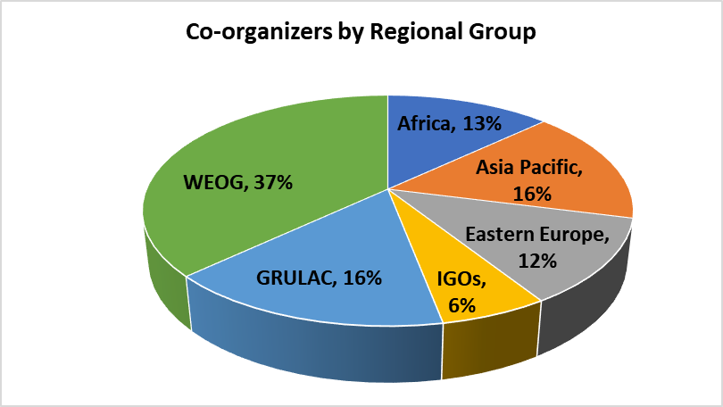
Organizing Teams - overall
732 stakeholders involved in co-organizing teams of 237 workshops.
127 organize multiple workshops. 605 organize one unique workshop.

Slide 6
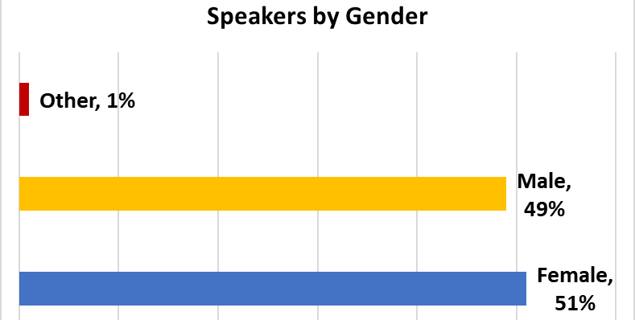
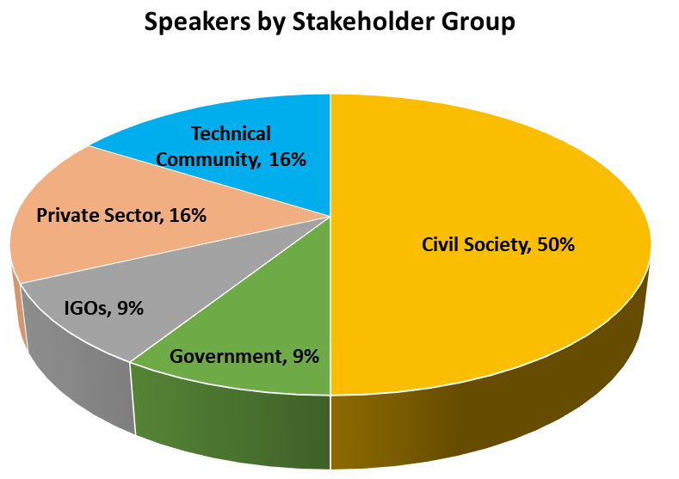
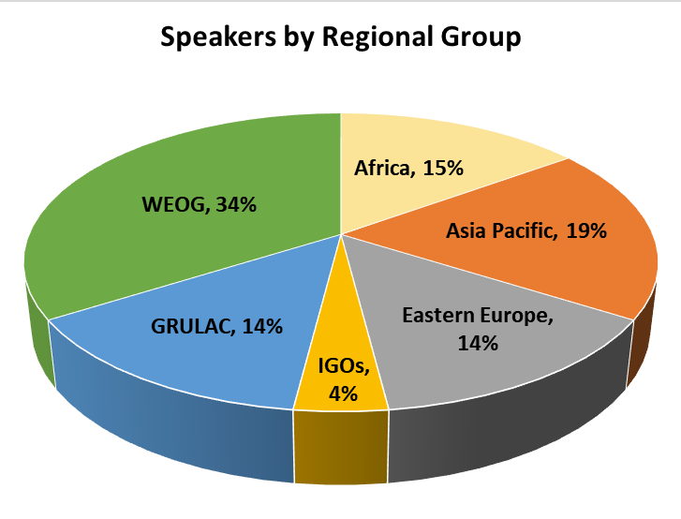
Speakers - overall
884 stakeholders proposed as speakers for 237 workshops.
769 unique speakers. 115 engaged as speakers in multiple workshops.

Slide 7
Topics per Thematic Tracks
Each proposer asked to submit between 1 and 3 topics.
Proposers could choose among the existing tags or create their owns.
In total, over 80 new tags/topics created by workshop proposers.

Slide 8
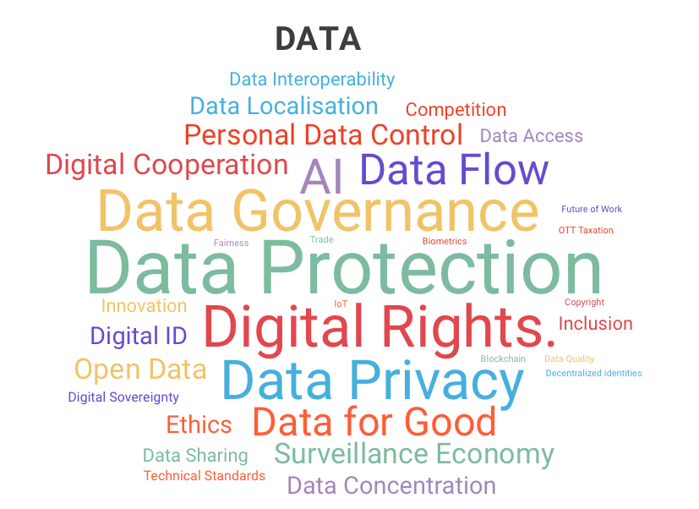
Data (138)
Top 10:
Data Protection
Digital Rights
Data Governance
Data Privacy
AI
Data Flow
Data for Good
Personal Data Control
Surveillance Economy
Digital Cooperation

Slide 9
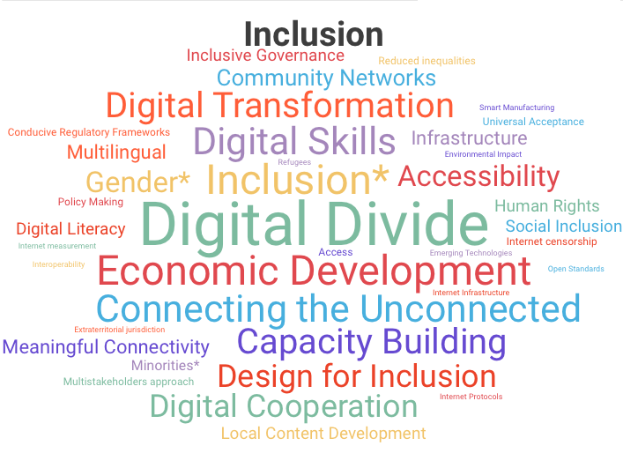
Inclusion (189)
Top 10:
Digital Divide
Economic Development
Inclusion
Connecting the Unconnected
Digital Skills
Accessibility
Capacity Building
Digital Transformation
Design for Inclusion
Digital Cooperation
*Community created tag

Slide 10
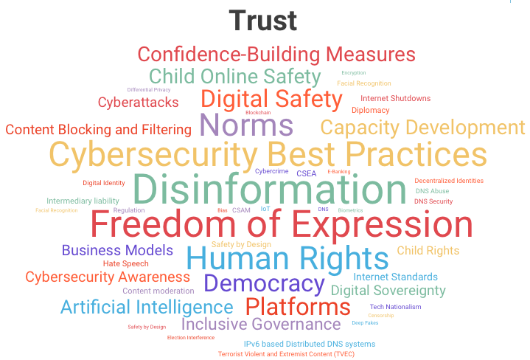
Trust (275)
Top 10:
Disinformation
Freedom of Expression
Cybersecurity Best Practices
Human Rights
Norms
Democracy
Digital Safety
Platforms
Child Online Safety
Confidence-Building Measures
*community created tag

Slide 11
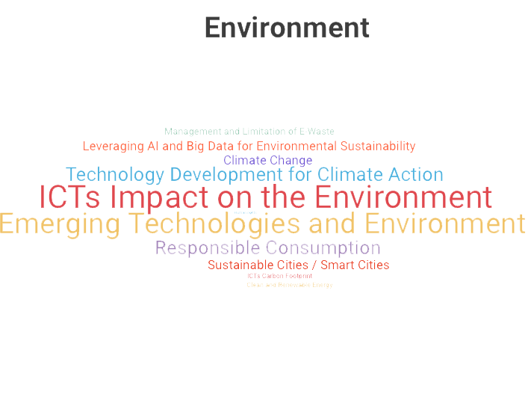
Environnent
Top 10:
ICTs Impact on the Environment
Emerging Technologies and Environment
Technology Development for Climate Action
Responsible Consumption
Climate Change
Leveraging AI and Big Data for Environmental Sustainability
Sustainable Cities / Smart Cities
*community created tag

Slide 12
Other Session proposals
30 Open Forums
45 Day 0 events
72 IGF Village Booths
16 Dynamic Coalitions
7 National & Regional Initiatives
9 remote hubs (call is still open)

Slide 13
Other Elements
Youth Track
Parliamentary Track
High-level Track

Slide 14
Thank You!

