Slide 1

IGF NRIs 2020
Deciding on thematic focus for 2020 NRIs sessions
Prepared by the IGF Secretariat

Slide 2
About
At the begging of each IGF cycle, the NRIs, through a bottom-up, open and inclusive call, decide on the topics their annual collaborative work will focus on.
In order to run this process for the IGF 2020 process, the following analyses were conducted as a key input to the NRIs for their final decision:
  Analysis of main policy areas all NRIs annual meetings in 2019 have focused on
  Analyses of responses the NRIs submitted to the IGF 2020 Call for Validation of Thematic Tracks
  Analyses of 2020 NRIs meetings hosted in January-February

Slide 3
Section A
NRIs Responses to the IGF 2020 Call for Validation of Issues

Slide 4
IGF 2020 Call for Validation of Thematic Tracks
About the Call for Validation of Thematic Tracks
Call Time Framework: 23 January - 6 February 2020 (2 weeks)
Stakeholders asked for feedback to thematic tracks the MAG proposed:
  Track one: Data
  Track two: Inclusion
  Track three: Trust
  And to advise on accommodating additional themes: environmental sustainability/climate change and ‎digital economy as integrated in the three main tracks or as an additional track with the title ‘Sustainability’.
Call asked for response to following questions:
  What issues, subthemes and/or policy questions or solutions should be addressed within ‎each of these three thematic tracks?‎
  What you believe are the most important issues, subthemes and/or policy questions or ‎solutions related to environmental sustainability/climate change and digital economy? ‎

Slide 5
NRIs Responses to IGF 2020 Call for Validation of Thematic Tracks
18 NRIs responded (less than 10% of all recognized NRIs). Overview of clustered proposal HERE (Sheet 2).
African IGF
Albania IGF
Benin IGF
Bolivia IGF
Brazil IGF
Burkina Faso IGF
Ecuador IGF
France IGF
Guatemala IGF
Italy IGF
Mauritius IGF
Nigeria IGF
North Africa IGF
Spain IGF
Swiss IGF
UK IGF
Vanuatu IGF
Youth IGF Uruguay

Slide 6
NRIs Responses to IGF 2020 Call for Validation of Thematic Tracks
Data | Inclusion | Trust | Sustainability (Environmental Sustainability + Climate Change + Digital Economy) | Suggestion for New Theme
15 NRIs expressed support | 11 NRIs expressed support | 11 NRIs expressed support | 6 NRIs expressed support for Sustainability | Children and Internet governance
Most common issues: privacy; protection; climate change; data for development | Most common issues: inclusion; vulnerable groups; access | Most common issues: trust; security; child protection | 7 NRIs expressed support for Climate Change | Digitalization of the multistakeholder model
 |  |  | 6 NRIs expressed support for Digital Economy | Education for all
 |  |  | Most common issues: e-waste; job creation; consumption; smart cities. | Blockchain and cryptocurrencies
* Some NRIs submitted multiple issues per theme, while other submitted a few, one or none.

Slide 7
Policy Questions:
Are legal mechanisms enough to secure and transform digital economy? Impact of AI on digital economy?
What are the consequences of increasing data concentration and technical development for individuals and our fundamental values? Does informational self-determination exist today or are citizens increasingly losing control over their data? How could a truly self-determined data space look like?
The two megatrends “digitalisation” and “climate change” are on everyone’s agenda. What are the interlinkages between the two? Can digitalisation help to combat the environmental and climate crisis, and if so, how?

Slide 8
Section B
NRIs Policy Discussion Areas in 2019

Slide 9
NRIs Policy Discussion Areas in 2019
Analyses based on comparison view of programme agendas of 80 NRIs meetings hosted in 2019
(inputs for each NRI gathered HERE, Sheet 1).
Inputs organized across 8 thematic clusters: Cybersecurity; Access and Inclusion; New and Emerging Technologies; Data; Digital Rights and Freedoms; Economic Issues and Sustainability; Technical and Operational Issues; IG Ecosystem*
(overview of clustered inputs HERE, Sheet 1).
_______________________________________________________________________________________________________________________
* These clusters are a slight modification of the IGF 2018 themes

Slide 10
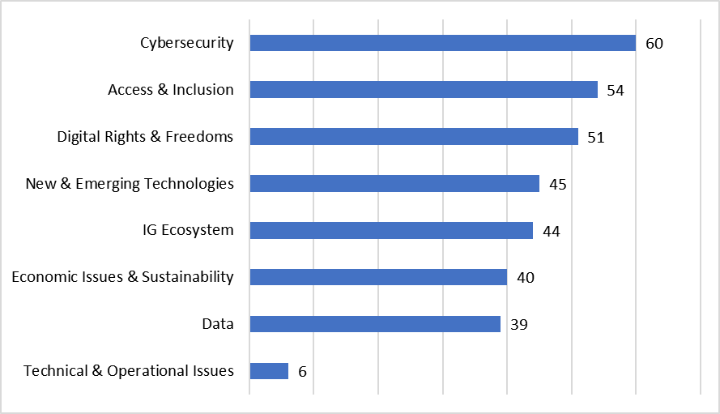
NRIs 2019 Policy Discussion Areas: Ranks

Slide 11
NRIs 2019 Policy Discussion Areas: most common Issues
Cybersecurity (60) | Access & Inclusion (54) | Digital Rights & Freedoms (51) | New & Emerging Technologies (45) | IG Ecosystem (44) | Economic Issues & Sustainability (40) | Data (39) | Technical & Operational Issues (6)
Cybersecurity (44) | Access (21) | Freedom of Expression Online (17) | AI (15) | Democracy, Digital cooperation, multistakeholder model, digital future (27+) | Digital Economy & Trade (17) | Data protection & governance (21) | Infrastructure
Safety (10) | Inclusion (19) | Online media regulation (15) | Emerging Tech & Issues (10) | Capacity Development (9) | ICTs for Sustainability (8) | Data privacy (8) | Critical Internet Resources
Child &Youth protection (9) | Connectivity (14) (Infrastructure; Public-private partnerships) | Digital rights (14) | Digital innovation (8) |  | Future of Work (6) | Open Data, Big Data (6) | DNS; ccTLD
Trust (7) | 5G, IPv6, IXP, Net Neutrality (5) |  |  |  | Taxation (4) | Ethics, Localization, Utilization | Tech Aspects of Internet governance
Encryption, IP abuse, DNS security | Digital literacy & skills (3) |  |  |  |  |  | Sustainability of Network
Capacity building |  |  |  |  |  |  | 5G; IXP

Slide 12
Section C
NRIs Policy Discussion Areas in 2020
(January – February 2020)

Slide 13
NRIs Policy Discussion Areas in 2020
By 24 February, 6 NRIs informed about their thematic programme focus for the 2020 cycle (Trinidad and Tobago; Arab IGF; Canada IGF; SEEDIG; EuroDIG; Russian IGF)
Based on these agendas, the current priority is with the following thematic clusters:
Digital Rights and Freedoms (6)
  Freedom of Expression; Content moderation; Media issues
IG ecosystem (6)
  Future of Internet; Digital Cooperation;
Access and Inclusion (4)
  Inclusion; Digital literacy; Connectivity

Slide 14
شكرا
谢谢
Thank You
Merci
Спасибо
Gracias

